Slide 1

SAP Build Training for Corporate Professionals
DAY-22
www.anubhavtrainings.com

Slide 2


DISCLAIMER
The training content and delivery of this presentation is confidential, and cannot be recorded, or copied and distributed to any third party, without the written consent of Anubhav Trainings

Slide 3
Agenda
Shopping cart
Create destination
Load data in list
Navigation

Slide 4
Parts
https://world.openfoodfacts.net/api/0/product/8901063029279?fields=product_name,nutriments,image_front_url

Slide 5
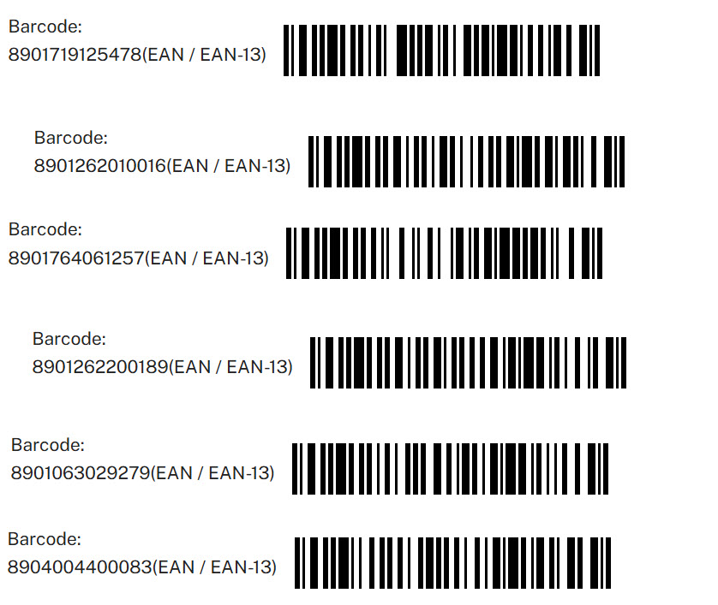

Test data

Slide 6
SAP UI5 v/s SAP Build Apps
Aspect | SAP UI5 | SAP Build Apps
Development Approach | Full-code development (JavaScript, HTML, CSS) | Low-code/no-code (drag-and-drop, minimal code)
Target Audience | Frontend developers, UI/UX designers, SAP developers | Business users, citizen developers, IT teams
Customizability | Highly customizable, full control over design and logic | Flexible with limits; customization possible with code
Ease of Use | Requires programming knowledge (JavaScript) | Very user-friendly, no/less programming required
Platform Type | UI framework for building custom web apps, Suitable for both cloud and on-premise apps | Low-code platform for full app development (web, mobile) suitable for cloud and native apps
APK support | Using Cordova plugin | Direct support to extract the APK
UI Components | Advanced, enterprise-grade UI components | Pre-built, basic UI components for rapid development
Integration with SAP Systems | Seamless integration with SAP backend (S/4HANA, Fiori, etc.) | Integrates with SAP and non-SAP systems via APIs
Integration with Third-Party Systems | Typically requires custom development | Easy integration with third-party systems via APIs
Flexibility in Design | Full flexibility for custom designs and behaviors | Limited flexibility compared to full coding, but extensible with logic
Complexity | High, requires technical knowledge and expertise | Low, accessible for non-technical users
Speed of Development | Slower, due to custom coding and in-depth UI design | Faster, thanks to low-code/no-code approach
Cost | High | Less
Use Case | Custom, enterprise-level applications with detailed UI | Rapid prototyping and app development for business needs
Extensibility | Fully extensible with custom code | Extensible with custom code but within a low-code environment
Maintenance | Requires ongoing developer involvement for updates | Easier to maintain, especially for non-technical teams
Learning Curve | Steep learning curve for developers | Low learning curve for non-technical users

Slide 7
Types of Dynamic variables
Dynamic variables are the backbone of your app logic. For the most part, the data they contain at any given time is determined by what flow functions have been called during the app runtime so far.
Page variables
Page variables exist in the context of a single page. When a page is removed from the navigation stack, its page variables are reset.
Data variables
Data variables are like page variables, but their schema is defined by the data resource they are linked to. They also come with default logic that loads the associated data from the backend and stores it in the data variable.
App variables
App variables exist in the global context of the app. When the app opens for the first time, or is closed and reopened, app variables are reset.
Page Parameters
Page parameters can only be of the text type. Page parameters are read-only variables that can be set with the Open page flow function for the new page, e.g. ID of a product for a product details page.
Theme variables
Theme variables define how the various view components look, giving you an easy way to change the whole look-and-feel of your app.
System variables
System variables define properties of the current app and the device its running on. They cannot be affected by the user directly, but change when the underlying property changes.

Slide 8
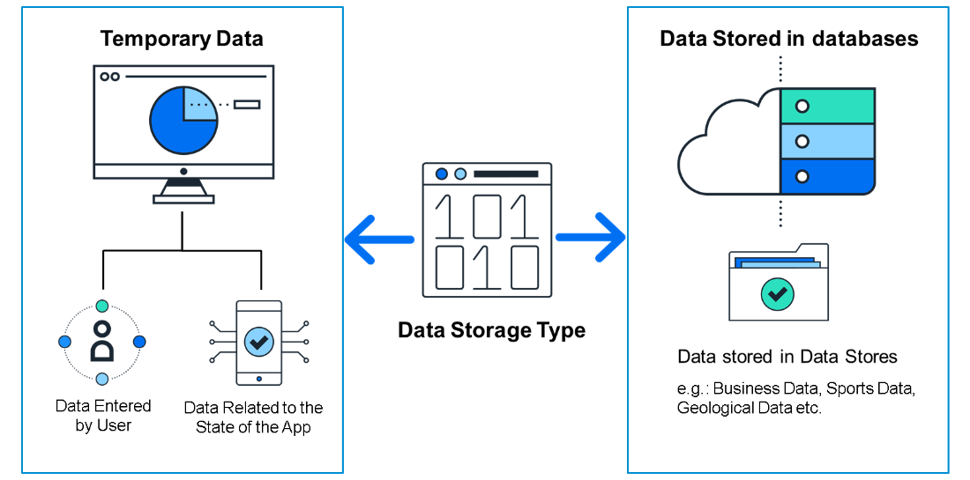
Data Resources in BTP
Applications live and die on their data, and without some form of data, an app wouldn’t be able to do much.
Some data is merely temporary and is stored while the app is running, such as:
Data entered by the user.
Data related to the state of the app; for example, while a user is playing a game, the app would need to store their score, name, and the current state of the board
Some data is stored in data stores or databases for use with other users, for example:
Business data, such as invoices and sales orders.
Sports data, such as teams and players and their statistics.
Geological data, such as earthquakes, their magnitude, and locations.

Slide 9
Types of Data Sources
There are different types of back-end systems from which you can retrieve data
SAP Build Apps lets you connect to the following:
OData Integration - This type of data resource lets you connect to OData services. OData services are services you reach with a URL and are designed for supplying business data. OData services conform to a rigid set of rules for defining the format of the URLs and of the returned data.
REST API Direct Integration - This type of data resource lets you connect to REST services. REST services do not need to conform to the same rigid rules for URLs and responses, as OData services do. This can make REST services require a little more work to understand, and to configure within SAP Build Apps.
On-Device Storage - This data resource actually creates a data store on the device the user is using, as opposed to REST and OData data resources, which connect to existing data stores. Such data is only stored on the current user’s device, so it is used for data needed only by the current user and that does not have to be shared.
Marketplace Data Resources - Marketplace data resources can be of any type. They are data resources that are defined and stored in the Marketplace and can be quickly installed from there. You may want to use the few data resources prebuilt for you, or you may want to create a data resource and be able to quickly reuse it in multiple projects.

Slide 10
Additional Data Resource types
There are some additional and important data resource types – especially for use in connecting to SAP back-ends – that depend on users being authenticated via SAP BTP
Visual Cloud Functions Integration - Visual Cloud Functions lets you easily create your own data store, not just connect to an existing one, and let multiple apps access it and let you share the data among many users.
OData Integration with BTP Destination - OData with a BTP destination is the same as without except that the URL and authentication is defined by an SAP BTP destination.
REST Integration with BTP Destinations - REST with a BTP destination is the same as without except that the URL and authentication is defined by an SAP BTP destination.

Slide 11
What is Destination in BTP
SAP BTP Destination is a configuration object within SAP Business Technology Platform (BTP) that allows applications to connect to external systems or services in a secure and managed way.
These destinations store connection settings like URLs, authentication, and proxy settings, enabling seamless communication between your BTP applications (like those running on SAP CAP, UI5, or Fiori) and other systems (such as on-premise SAP systems, third-party APIs, or cloud services).

Slide 12
Create destination to simple OData Service
Type=HTTP
HTML5.DynamicDestination=true
Authentication=NoAuthentication
Name=AnubhavOData
WebIDEEnabled=true
sap.processautomation.enabled=true
sap.build.usage=odata_gen
ProxyType=Internet
URL=https://orderscapapp.cfapps.eu10.hana.ondemand.com/service/OrderManagement
Appgyver.Enabled=true
sap.applicationdevelopment.actions.enabled=true
Images:
https://ui5.sap.com/test-resources/sap/m/demokit/cart/webapp/localService/mockdata/images/HT-1020.jpg

Slide 13

Scenario – Shopping cart App
🧑‍💼 Persona: Alex Taylor – Procurement Manager
Age: 34
Location: Chicago, USA
Industry: Manufacturing
Role: Manages procurement for factory suppliers
Goals:
Quickly find suppliers
Ensure availability to take orders based on size
anage suppliers
🎯 Objective
Design a user-friendly mobile app that allows Alex to:
Browse available products
View detailed product information
Add items to a shopping cart
Place and track orders

Slide 14
Binding Concept
You created a data variable for the Products data, and the logic for retrieving the data was created automatically. Now you need to tell the app what to display.
To do this, you create bindings for your UI components, indicating what data you want to display in your component, whether from:
Static values
Calculated values
Values from variables
… or other sources
How Binding works
When you configure a UI component (or later a logic component called a “flow function”), generally you do this with binding.
For most properties, there is a binding icon that indicates what type of binding is used. For example, you can use static text for a text field, or you can show text from a backend service and use a binding to a data variable.

Slide 15
What is repeat?
The Repeat with property lets you create multiple copies of a component by supplying a list – this will repeat the component based on the number of elements in your list, for example, the number of products in our list. The list can be hardcoded, or can be located in a variable (like in our case), or based on a formula.
Once you set the Repeat with property, you then get the Data item in repeat binding option for the other properties in the component. You can now access values within each list item. So the data in the first item will be displayed in the first copy of the component, the data in the second item in the second copy of the component, and so on.

Slide 17

What We Did
Let’s Summarize
www.anubhavtrainings.com

Slide 18
www.anubhavtrainings.com
Thank You
End of Day 21
www.anubhavtrainings.com

Slide 19


We’re committed to empower you to be
#FutureReady
through powerful training solutions.
We build the workforce of the future.
250+
Corporate Clients
30,000+
Learners Trained
25000+
Learners Placed
FREE WEBINARS
Sign up for free webinars with industry experts every fortnight!
Enroll Now!
Contact us today!
https://anubhavtrainings.com

